Slide 1
DSRIP Cardiovascular Project Refresher Training
  Maria D’urso, RN; Administrative Director Community Medicine
  Margaret Cartmell, RN; Clinical Director Community Medicine

Slide 2

DSRIP Cardiovascular Project Overview
The goal of this DSRIP Cardiovascular project is to ensure clinical practices in the community and ambulatory care setting use evidence based strategies to improve management of cardiovascular disease
These strategies are focused on improving practitioner population management, adherence to evidence-based clinical treatment guidelines, and the adoption of activities that will increase patient self-efficacy and confidence in self-management

Slide 3
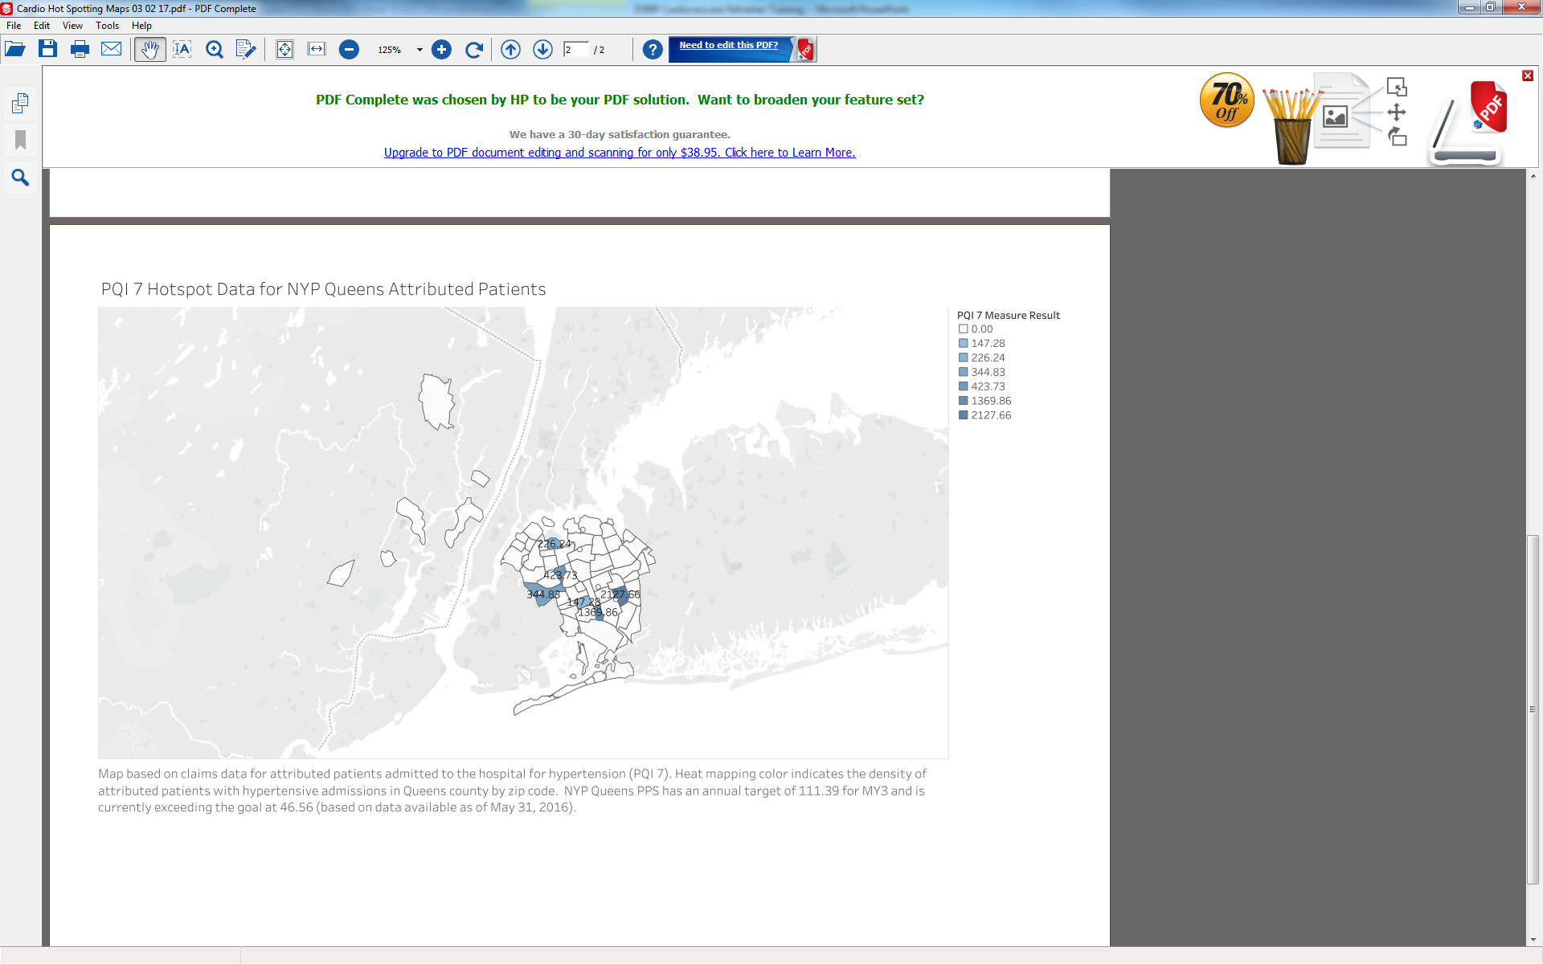

Slide 4
Training Overview
Overview of Million Hearts Initiative
Hypertension, Elevated Cholesterol & Medication Management
Blood Pressure Competency checklist
Blood Pressure Monitoring at Home
5A’s of Tobacco Control
Care Coordination
Questions

Slide 5
Million Hearts Initiative
Million Hearts is a U.S. Department of Health and Human Services initiative, co-led by the Centers for Disease Control and Prevention (CDC) and the Centers for Medicare & Medicaid Services (CMS), with the goal of preventing one million heart attacks and strokes by 2017
Strategies from the Million Hearts Campaign (http://millionhearts.hhs.gov) are strongly recommended in DSRIP project
NYP Queens PPS, with reference to Million Hearts strategies and in collaboration with partner feedback has developed policies and protocols for better management of patients with cardiovascular diseases.

Slide 6
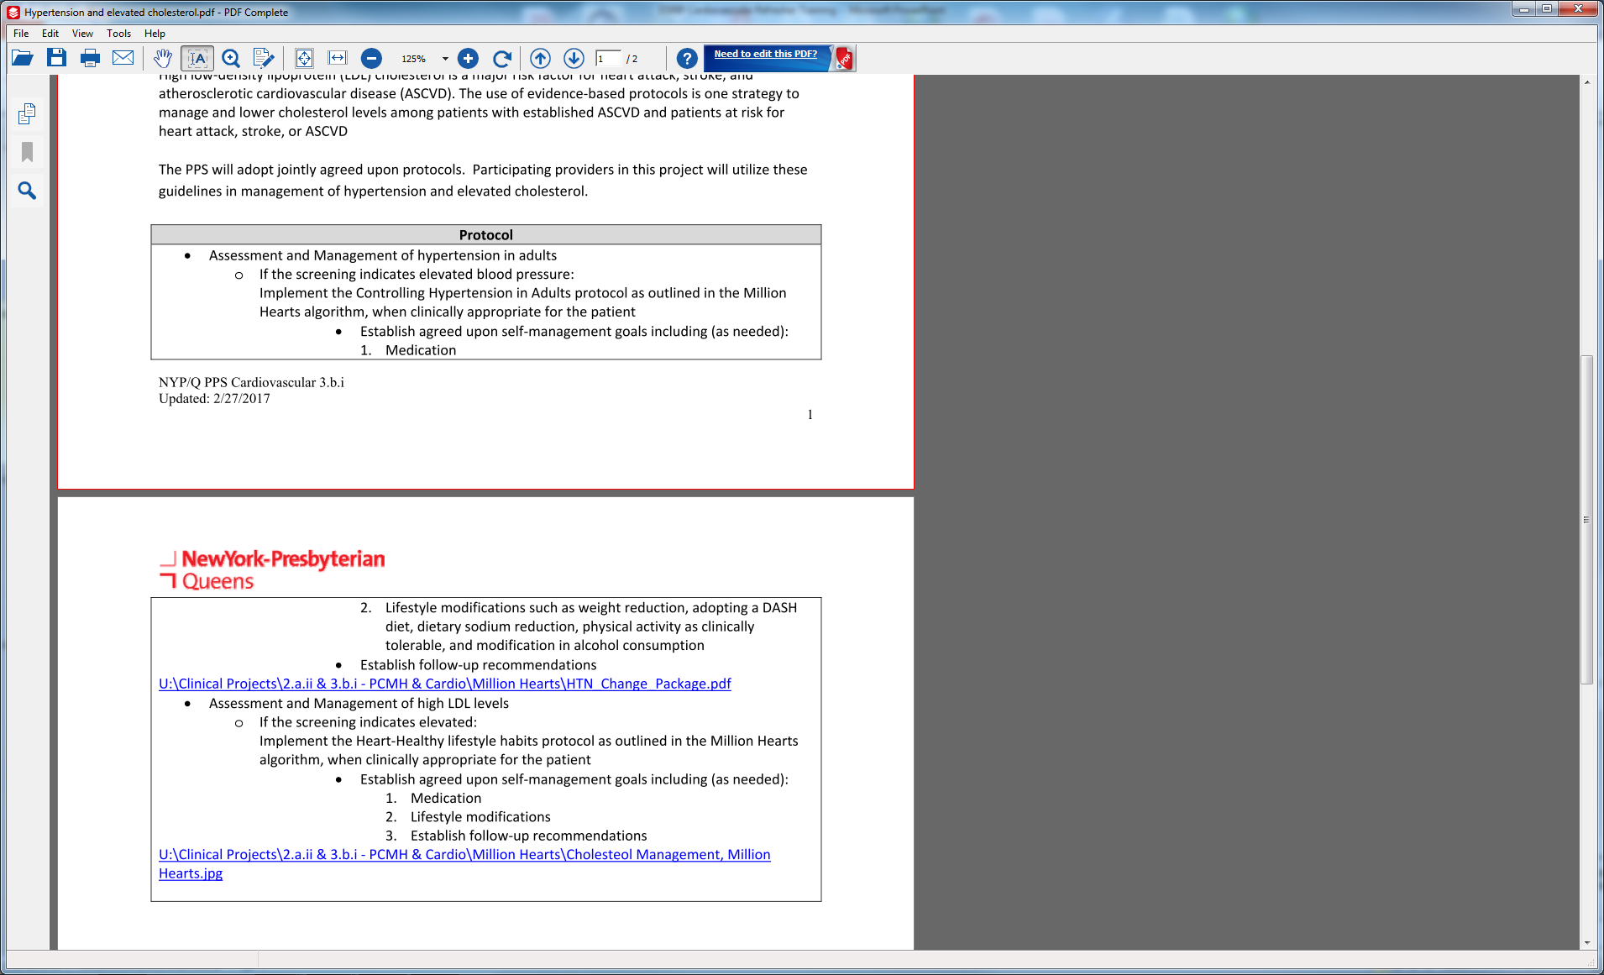
Hypertension and Elevated Cholesterol & Medication Management

Slide 7
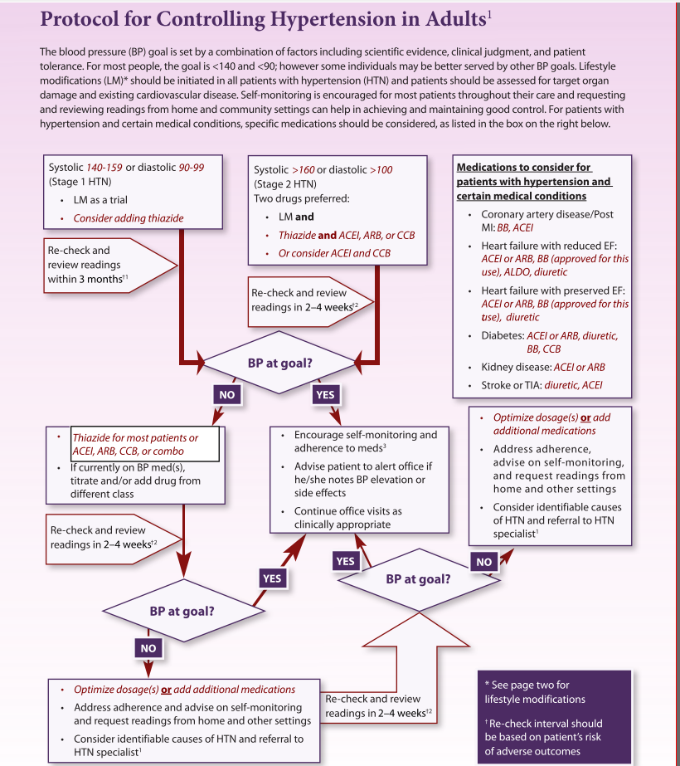

Slide 8
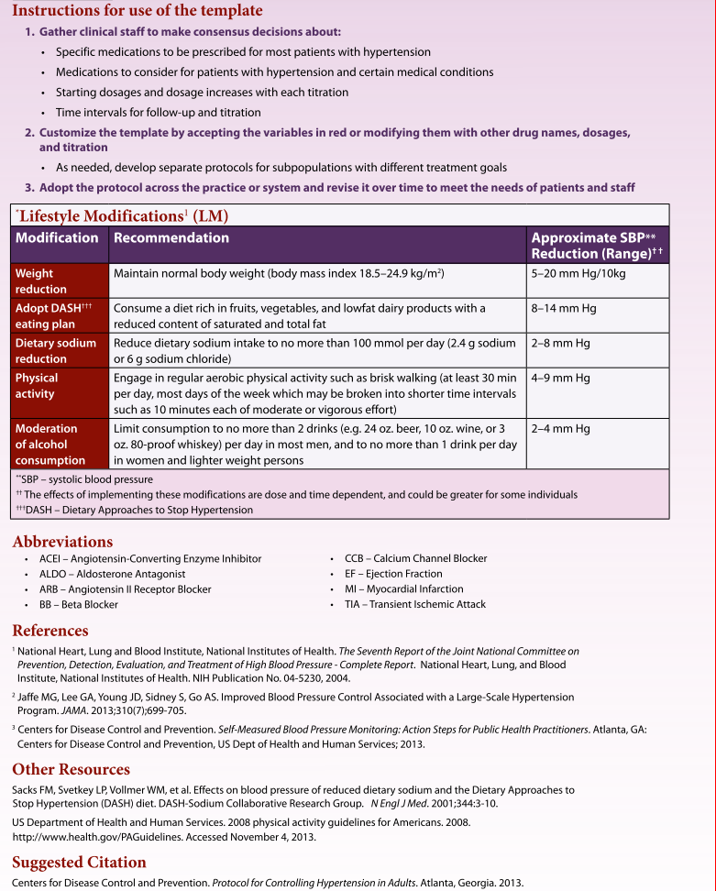

Slide 9
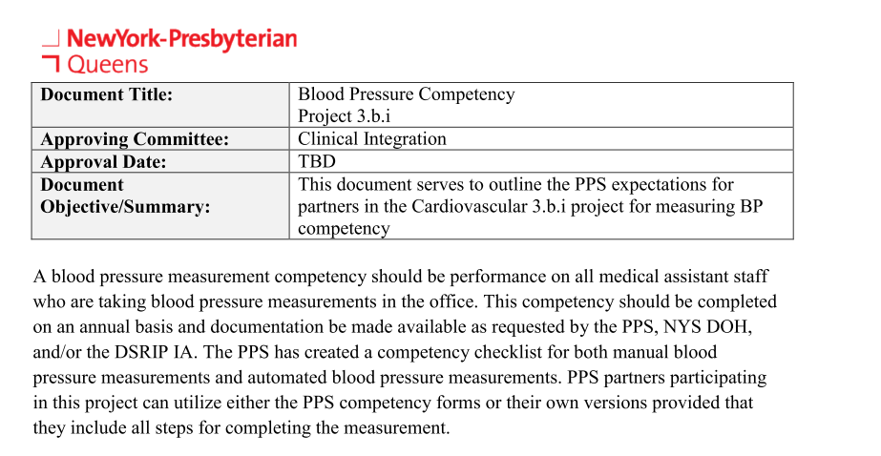
BP Competency Checklist

Slide 10
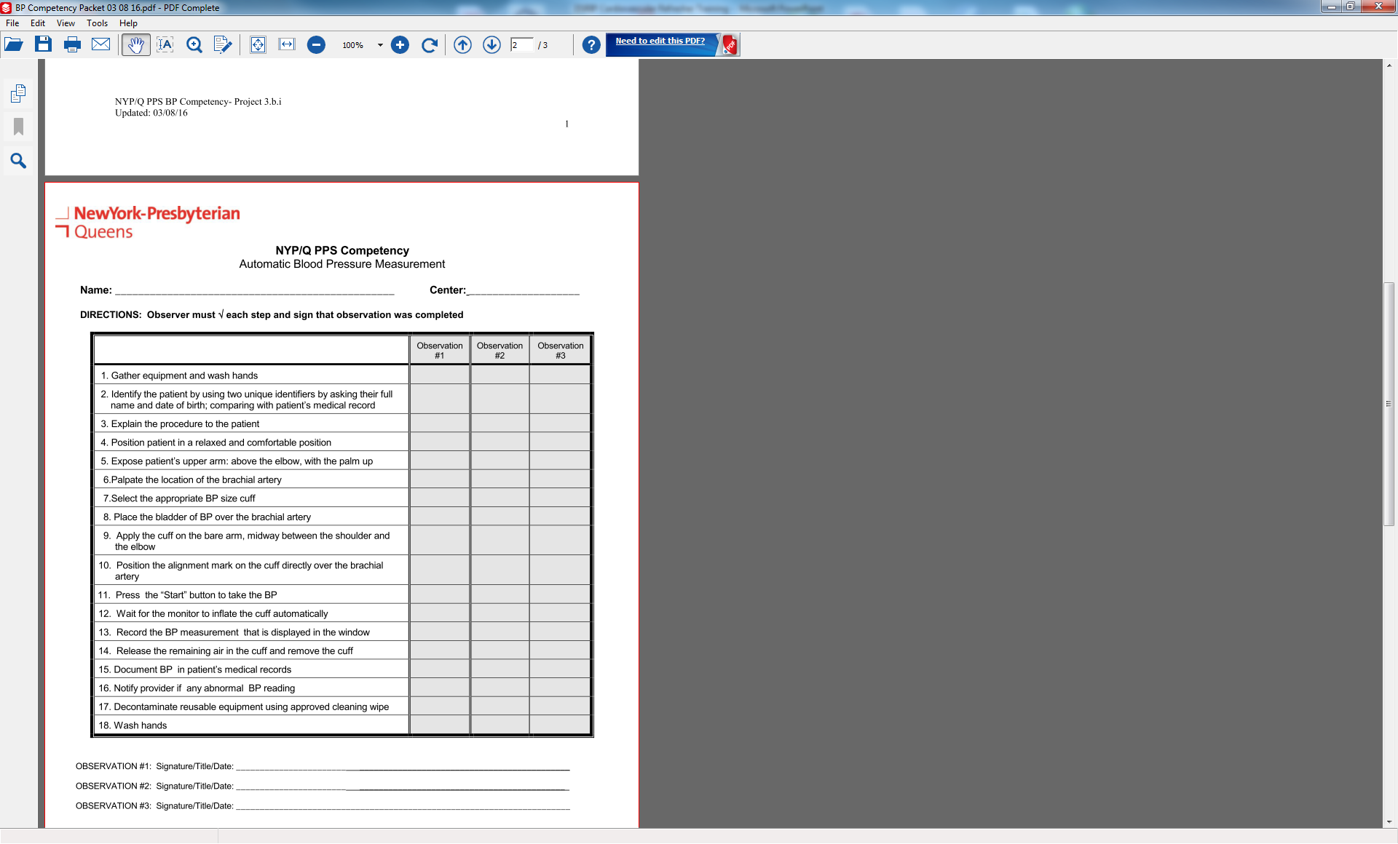

Slide 11
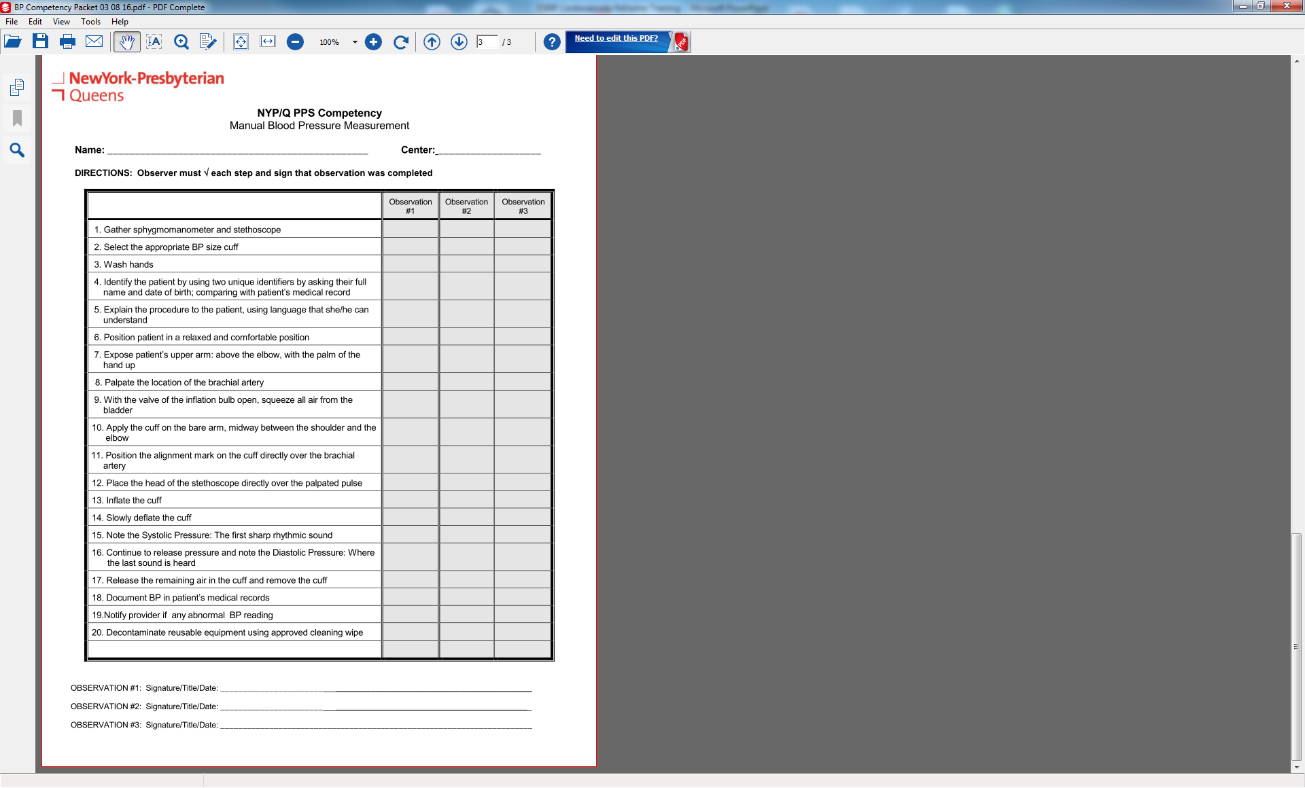

Slide 12
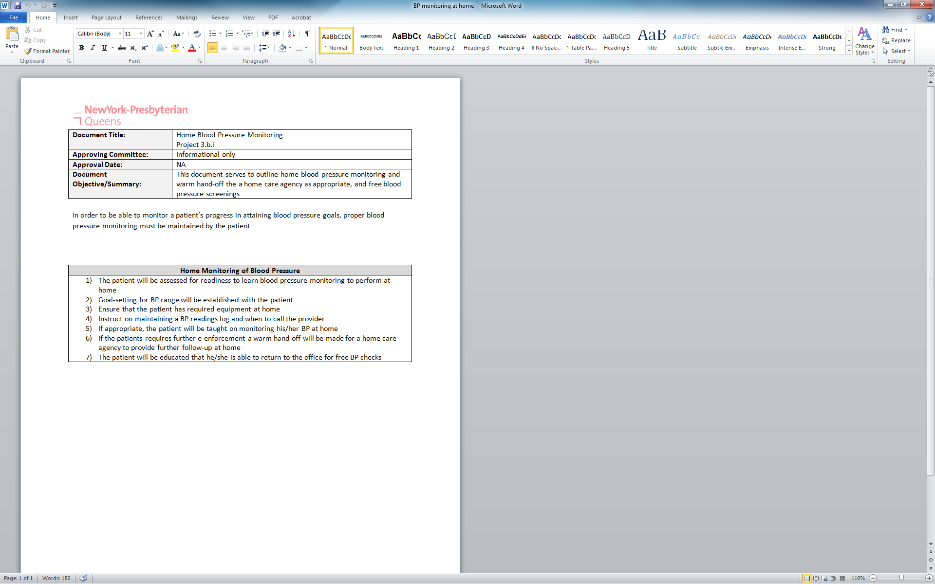
Blood Pressure Monitoring at Home

Slide 13
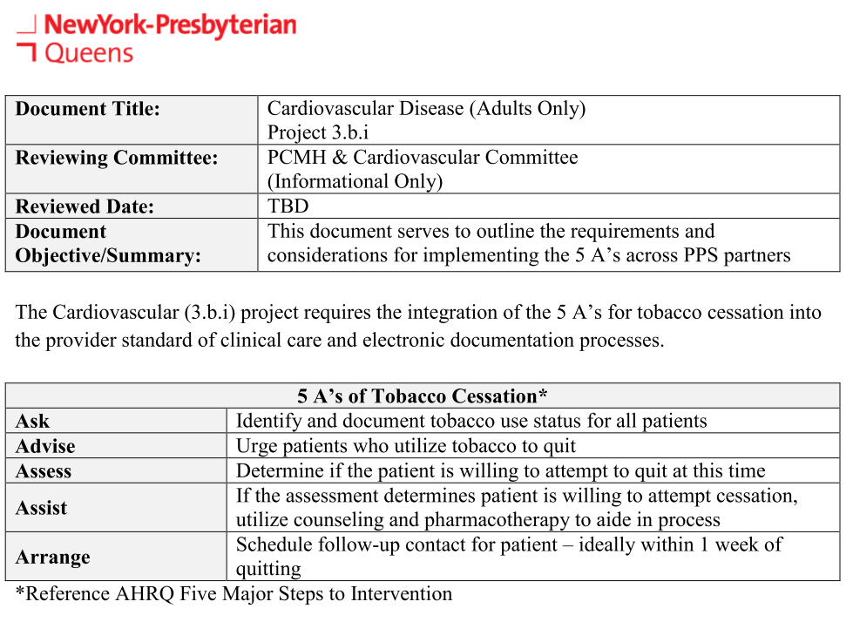
5 A’s of Tobacco Control

Slide 14
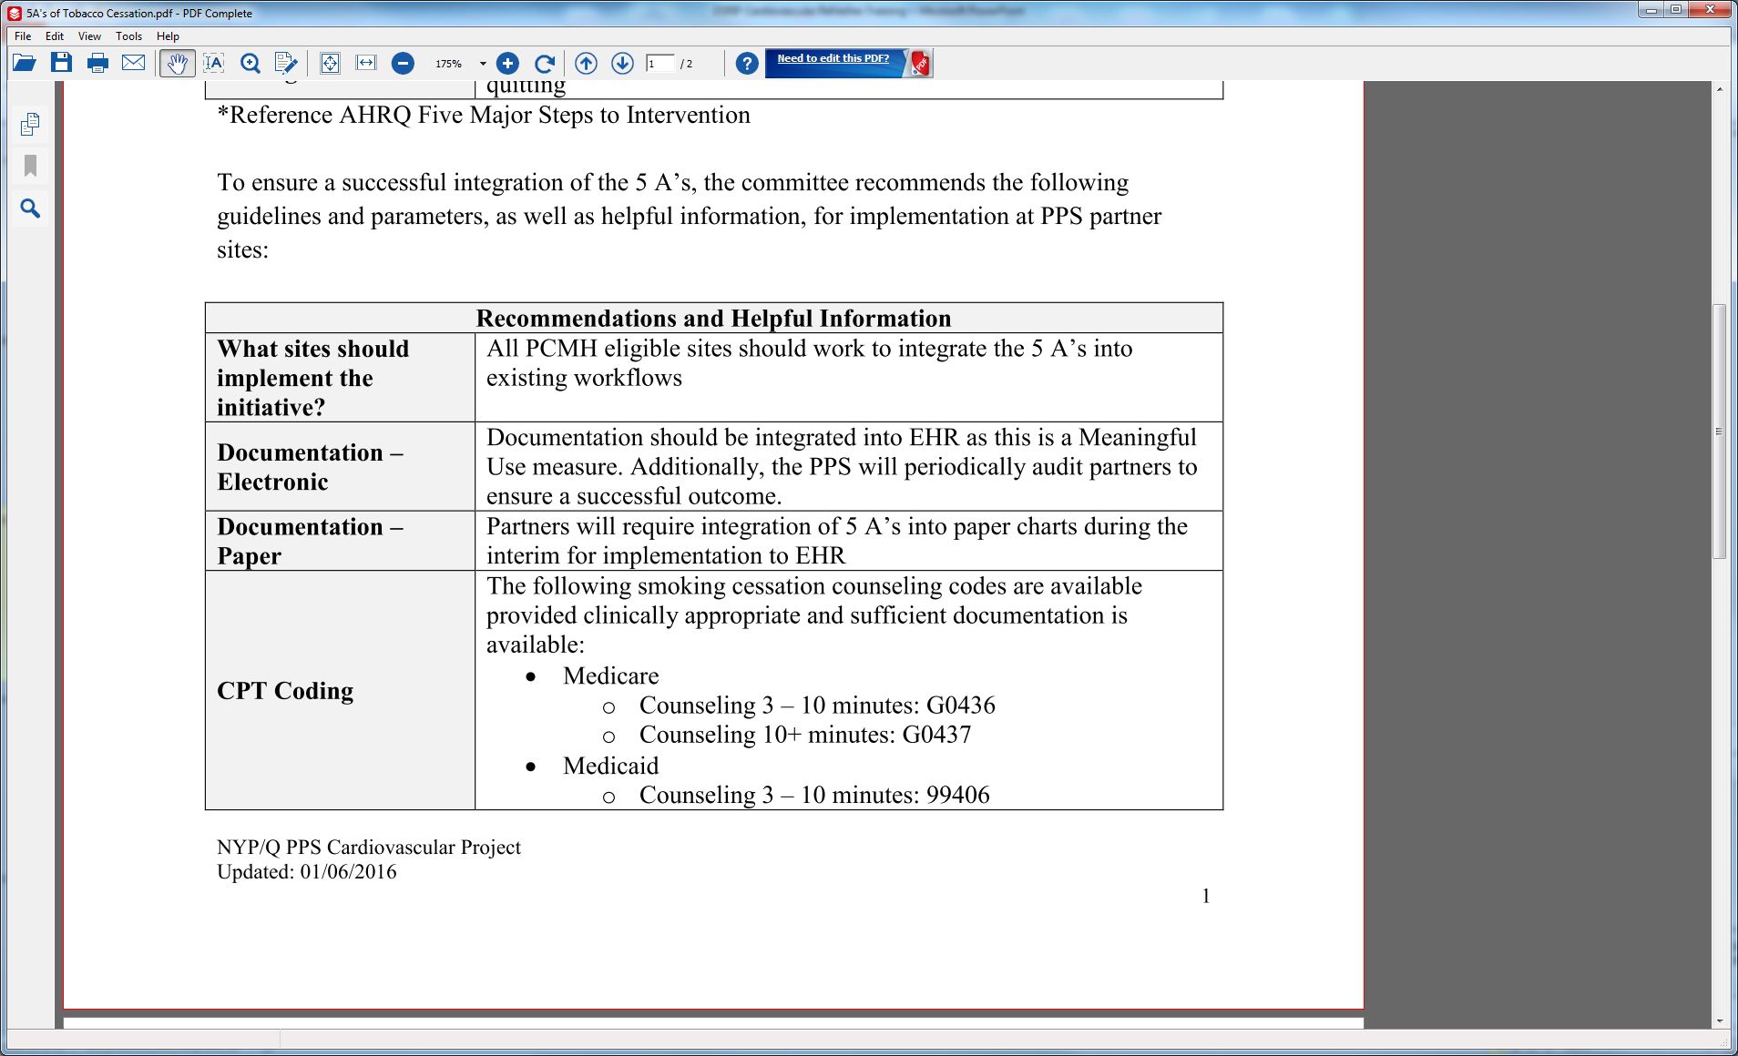
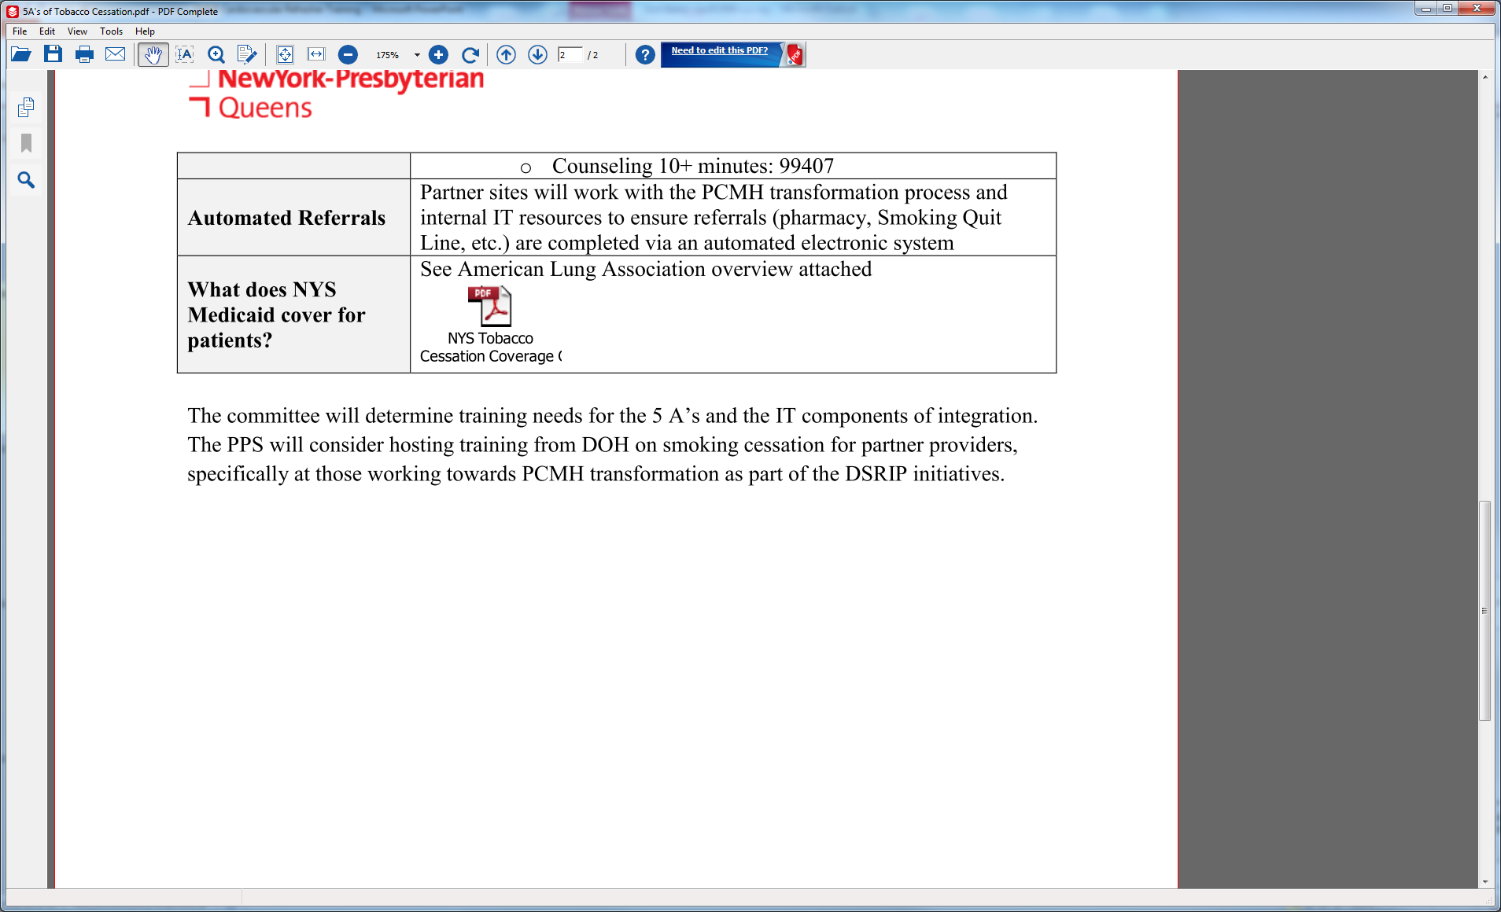
5 A’s of Tobacco Control, cont’d

Slide 15
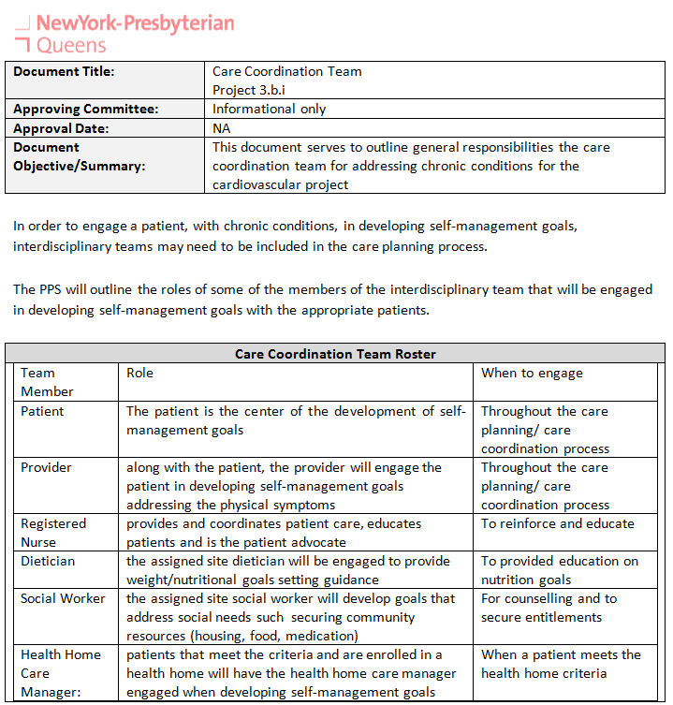
Care Coordination

Slide 16

Questions???

